Slide 1
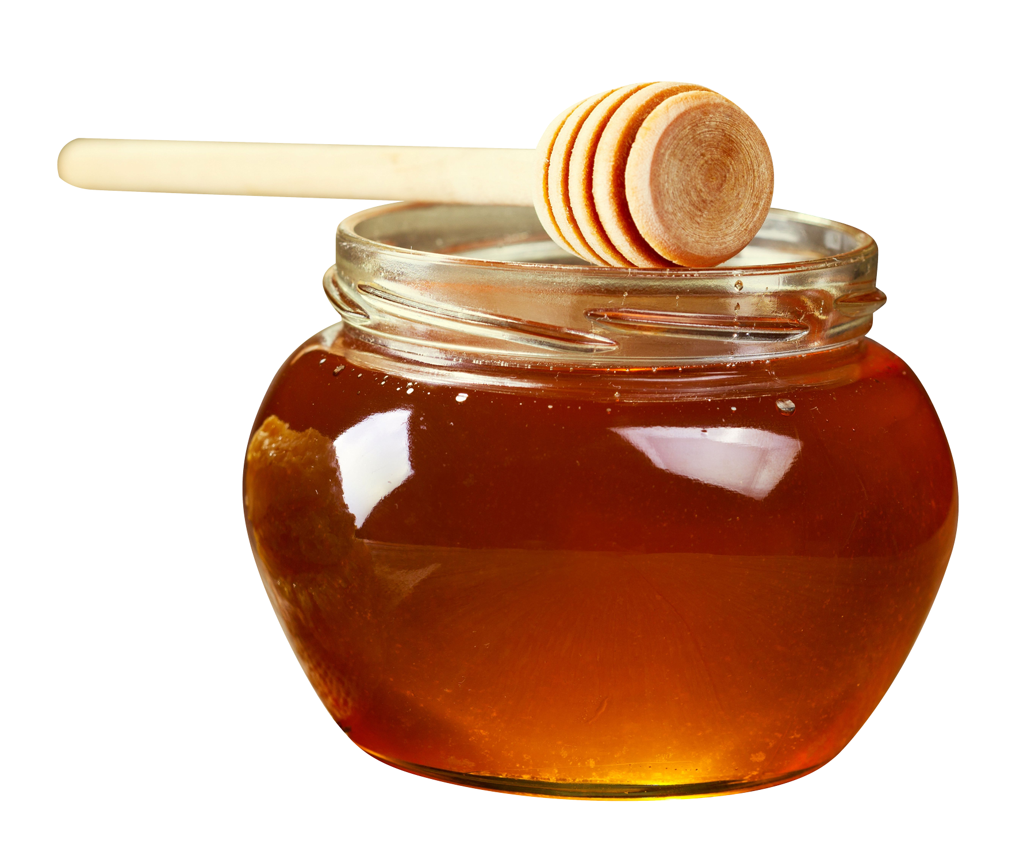
Honey Price Prediction
Sonali shinde

Slide 2
* problem statement *
A honey price prediction involves data analysis and machine learning techniques to predict the future prices of honey. The project typically includes collecting and preprocessing data, selecting appropriate machine learning models, training and evaluating the models, and finally deploying the predictive model to make future price prediction.

Slide 3
Flow Chart
Data Collection
Data Collection
Data Cleaning
Basic Dataframe 1
EDA - Outliers and Skewness
Dataframe 2
Feature Selection
DataFrame 3

Slide 4
About Dataset
Dataset has 247903 rows with 11 columns divided into train and test datasets respectively.
Variable “Price” is considered as the target variable which represents the price of honey.
Honey Price model has a dependent variable(Price) which is numerical in nature, so it’s a regression problem. I have opted for a linear regression to go for this analysis.

Slide 5
data cleaning
Missing Value Treatment
Data Type Conversion

Slide 6
Basic model
Sr.no | Model Name | R-square | Adj-R2 | MSE
1 | Linear | 0.189691 | 0.189650 | 44091.650082
2 | Lasso | 0.188719 | 0.188678 | 44157.262306
3 | Ridge | 0.189691 | 0.189650 | 44091.678632
4 | XGB Regressor | 0.999992 | 0.999992 | 0.489739
5 | Random Forest Regressor | 1.000000 | 1.000000 | 0.015764
The conclusion from above dataframe is XGB Regressor is best suited for this data .

Slide 7
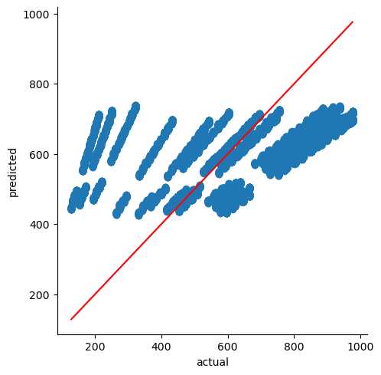

Slide 8
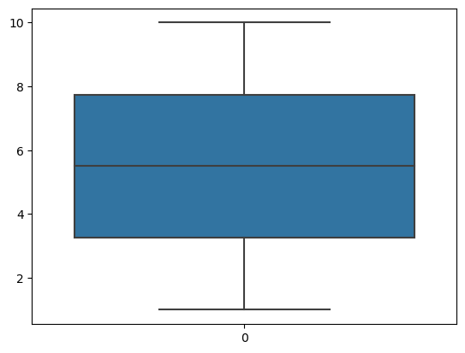
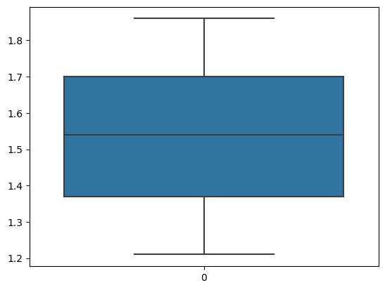
outlier treatment
# Data having no outliers
Boxplot of “CS” Boxplot of “Density”

Slide 9
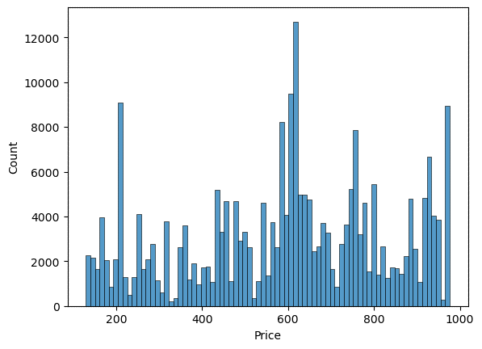
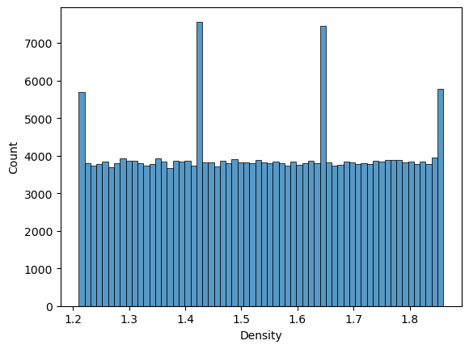
Visualization

Slide 10
dataframe 2
 | Model Name | R-square | Adj-R2 | MSE
0 | Linear | 0.189691 | 0.189650 | 44091.650082
1 | Lasso | 0.188719 | 0.188678 | 44157.262306
2 | Ridge | 0.189691 | 0.189650 | 44091.678632
3 | XGB | 0.999992 | 0.999992 | 0.489739
4 | Random Forest | 1.000000 | 1.000000 | 0.015854
The conclusion from above dataframe is XG Boost Regressor is best suited for this data .

Slide 11
Feature Selection
Lasso Regression

Slide 12
dataframe 3
 | Model Name | R-square | Adj-R2 | MSE
1 | Linear | 0.189691 | 0.189650 | 44091.650082
2 | Lasso | 0.188719 | 0.188678 | 44157.262306
3 | Ridge | 0.189691 | 0.189650 | 44091.678632
4 | XGB | 0.999992 | 0.999992 | 0.489739
5 | Random Forest | 1.000000 | 1.000000 | 0.015854
6 | Feature Selection | 0.189682 | 0.189650 | 44093.183602
7 | XGB | 0.999992 | 0.999992 | 0.454768

Slide 13
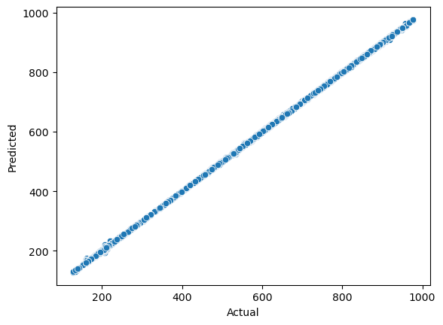
# The conclusion from above dataframe is XG Boost Regressor is best suited for this data .

Slide 14
# Demerits
If the prediction model only considers a limited set of factors influencing honey prices, it may not capture the full complexity of the market dynamics.
If the prediction models relies heavily on historical data , it may not adapt well to sudden changes or unforeseen events in the honey market.

Slide 15
Thank You !!
Ask me query if you have !

